Slide 1
IMO Special Event on Women, Ports and Facilitation My Path to Maritime
Jeanne M. Grasso
Blank Rome LLP
April 10, 2019
London
The information contained herein is abridged and summarized from numerous sources, the accuracy and completeness of which cannot be assured. This should not be construed as legal advice or opinion and is not a substitute for the advice of counsel.

Slide 2
Childhood

Slide 3
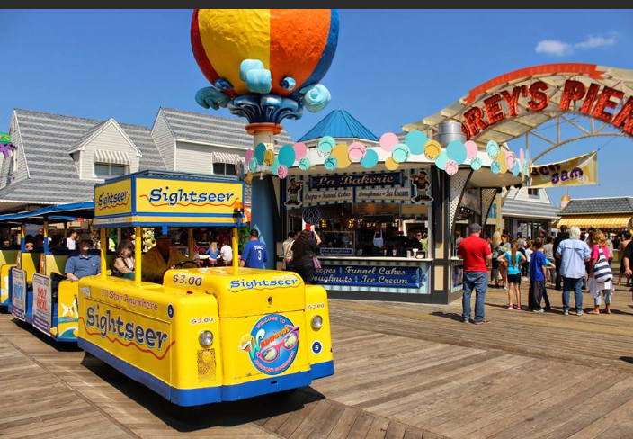
Youth

Slide 4
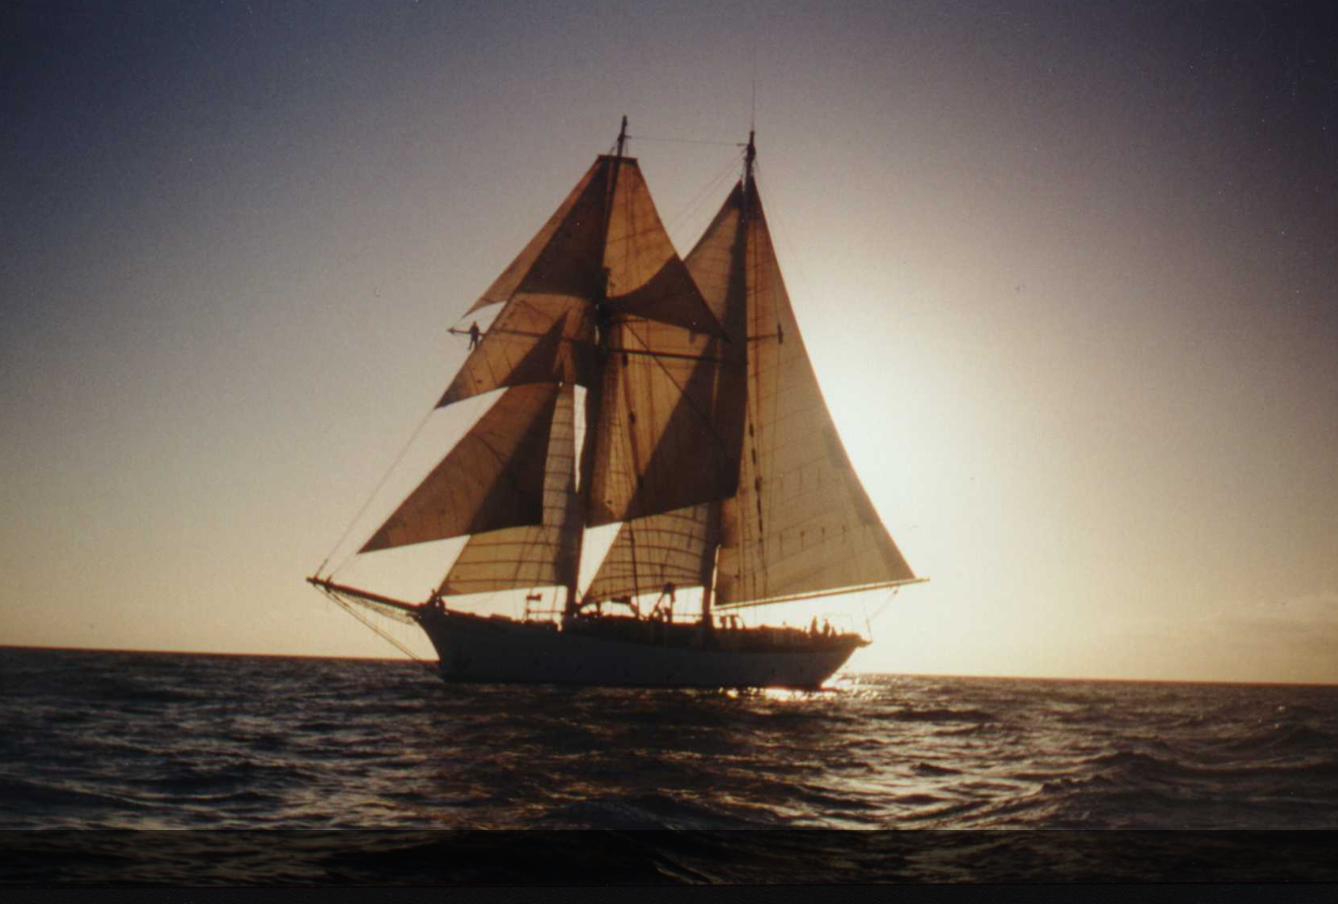
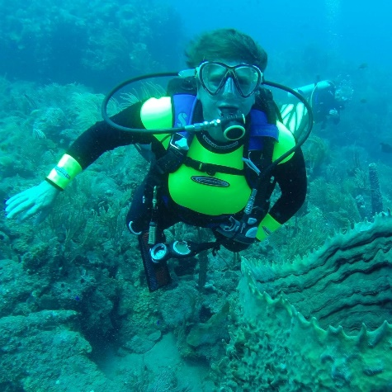
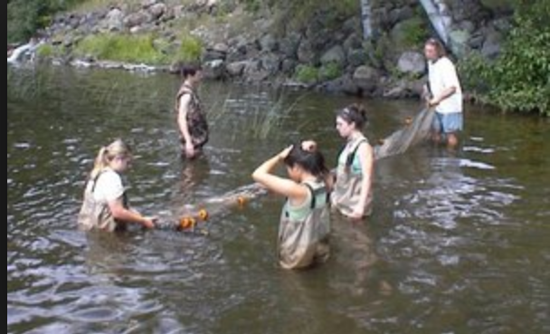
College – Biology Major and SEA Semester

Slide 5
Grad School – Masters in Marine Affairs and NOAA Fisheries Observer in Alaska

Slide 6
DC – NOAA Sea Grant Fellowship on Capitol Hill with the House Merchant Marine and Fisheries Committee

Slide 7
And, Jacques Cousteau never called…

Slide 8
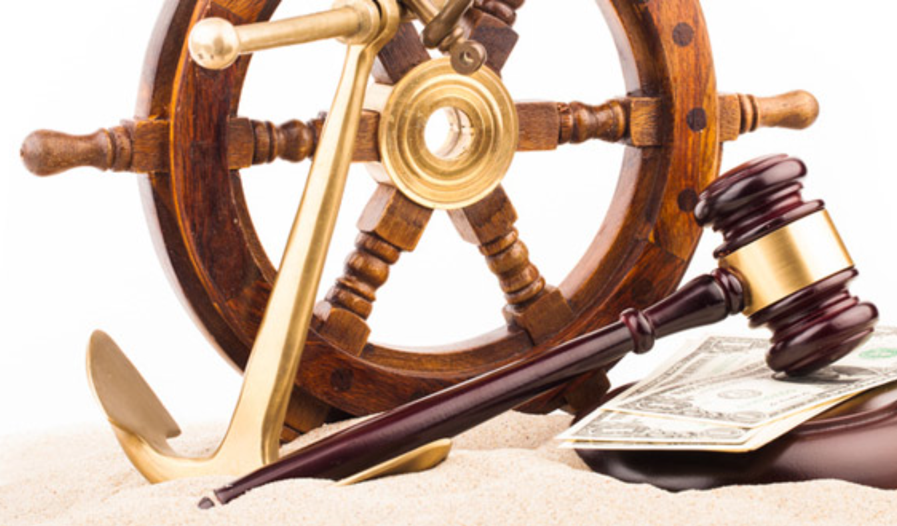
So, a few years later…maritime law.

Slide 9
And then, WISTA – Women’s International Shipping & Trading Association
3,000+ Members
45 National WISTA Associations
Our Vision
is to promote diversity in the maritime, trading and logistics sectors,
empowering women to lead through their unique perspective and competencies, with the conviction that gender diversity is key in providing a sustainable future for the shipping industry internationally.

Slide 10
And, research shows…
Women are significantly under represented in the maritime industry.
Generally, you can just look around the room…
Women hold:
55% of junior level positions
37% of professional level positions
17% of manager level positions
12% of director level positions
9% of executive level positions
Maritime HR Association Survey
National Shipowner Associations:
6% of national board members are women
30% at director or policymaking positions
International Chamber of Shipping

Slide 11
IMO World Maritime Day Theme 2019
Many options for WISTA to tie in and spread the word

Slide 12
WISTA International Pledge for inclusion of women in the shipping industry
WISTA Pledge for Diversity & Inclusion
“Women Move the World”
“Embrace diversity of thought (including gender, race, ethnicity, and age), and contribute to a merit-based business environment within my organisation.
I will be a champion of equal opportunity and equal pay.
My behaviour will reflect how I wish our industry to behave in the future.
I will work – and encourage others to work – toward a diverse and inclusive maritime sector.”
You can also sign the pledge at: https://wistainternational.com/pledge

Slide 13
The Role of WISTA - Bridging the Gap
Worldwide reach, now with IMO consultative status
Voice for stronger collaboration
Promote gender diversity and inclusion
Encourage gender blind corporate decisions
Partnerships
Work with governments, the maritime industry, and associations to help bridge the gap
Access to outstanding talent
Skilled executives
Corporate culture changes
Retention of skilled women
Women doing business with women
Participation on panels

Slide 14
Optimistic About the Future
IMO Consultative Status
Contribution to UNCTAD Review (2017 and 2018)
WISTA & Institute of Chartered Shipbrokers Scholarship Program
MOU with the Organization of American States/Committee on Ports
ISWAN, WISTA and Industry co-published “Gender Diversity, Towards Building and Maintaining a Diverse Shipboard Team”
Founding Partners of European Commission’s Platform for Change
IMO Glofouling Project Strategic Partner
Numerous new NWAs in the pipeline
Annual International Conferences – 2019 in Grand Cayman
Regional Conferences – Africa, Asia, Americas, Med

Slide 15
Growth, Continuity, Sustainability

